Slide 1
Probabilistic Latent Variable Models for Knowledge Discovery and Optimization
Xiaolong Wang
Department of Computer Science
Oct-17-2016
Doctoral Committee:
Prof. Chengxiang Zhai, Chair
Prof. Jiawei Han
Prof. David Forsyth
Prof. Angelia Nedich, UIUC & ASU
Prof. Joy Ying Zhang, CMU & Facebook

Slide 2
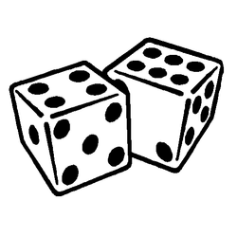
We must become more comfortable with probability and uncertainty
⎻ Nate Silver
Notes:
Nate Silver is a statistician who analyzes baseball and elections.
Forecast player performance based on measurements such as batting average for hitters or strikeout rate for pichers
Regression
Clustering players
Silver successfully called the outcomes in 49 of the 50 states in the 2008 U.S. Presidential election
In the 2012 United States presidential election, Silver correctly predicted the winner of all 50 states and the District of Columbia
Classification

Slide 3

An Era of Abundant Data
How To:
Represent the data and knowledge?
Model uncertainty and noise?
Scale well to large data?
Network
Text
Probabilistic Modeling
with Latent Variables
Images
Notes:
With increasing amount of the different types of data, how to we extract useful information?
In social network, who are spammers? How to find communities and how to characterize?
In news, how to find emerging topics? In literature, how to generate short summary for research evolution
Image recognition and segemantation

Slide 4
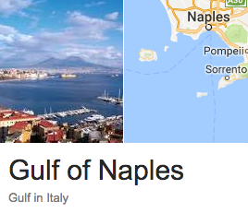
PLVM – An Historical Account
L
1893
W
R = W / L
Ratio of forehead width to the body length of 1000 crabs
Raphael Weldon
1860 - 1906
Notes:
Weldon collected 1000 crabs in Naples Bay in 1893 and
Measured the ratio of forehead width to the body length.
He plotted the histogram and fitted with a normal distribution.
However, he has his own doubts: there is a
“A well-marked deviation from this normal shape”
And he thinks
“the units grouped together in the measured material are
Not really homogeneous”
In other words, he hypothesized that the crabs are possibly
coming from two subspecies
With limited math knowledge, he turned to Pearson for help

Slide 5
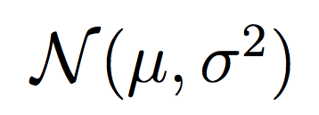
PLVM – An Historical Account
L
1893
W
R = W / L
Ratio of forehead width to the body length of 1000 crabs
Raphael Weldon
1860 - 1906
Karl Pearson
1857 - 1936
“A well-marked deviation from this normal shape”
A single normal fitting with
Maximum Likelihood Estimation (MLE)
“the units grouped together in the measured material are not really homogeneous??”
Notes:
Weldon collected 1000 crabs in Naples Bay in 1893 and
Measured the ratio of forehead width to the body length.
He plotted the histogram and fitted with a normal distribution.
However, he has his own doubts: there is a
“A well-marked deviation from this normal shape”
And he thinks
“the units grouped together in the measured material are
Not really homogeneous”
In other words, he hypothesized that the crabs are possibly
coming from two subspecies
With limited math knowledge, he turned to Pearson for help

Slide 6
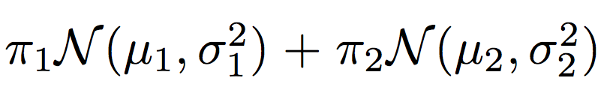
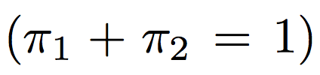
PLVM – An Historical Account
Karl Pearson
1857 - 1936
Model of 5 free variables
Matching on first 5 moments
Solving a 9th-degree polynomial
Two-normal fitting with Moment Matching (MOM)
Notes:
Pearson used two normal distributions to fit the data.
Nowadays we can use EM algorithm to compute the MLE.
At Pearson’s time computer was not invented yet so he chose to
Use moment matching (he also invented mom!).
Here we have 5 free variables, and thus we need to do moment
Matching up to the 5th moments.
Still this was a tedious computation task which amounts to a 9th
Degree poly
We plot the two curves of the component and their mixture is also
Shown which indeed seems a better fitting than walden’s result

Slide 7
PLVM – An Historical Account
Raphael Weldon
1860 - 1906
Karl Pearson
1857 - 1936

Slide 8
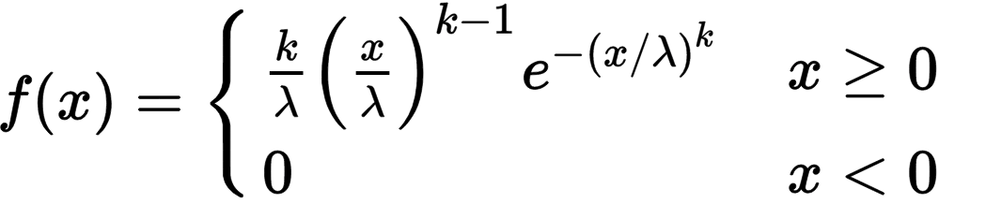
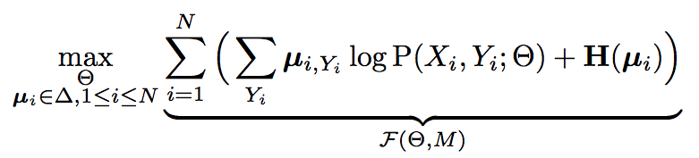
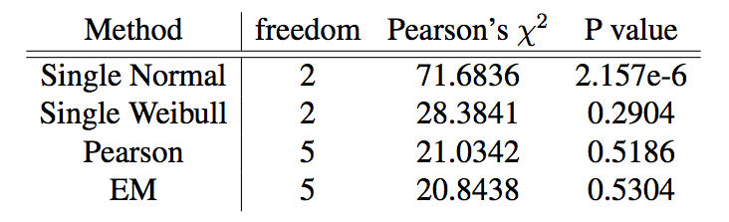
PLVM – An Historical Account
Modern alternatives:
Weibull Distribution
Two-normal with EM
MLE approximation
Why PLVM?
Flexible Modelling
Powerful Tool for KDD
Efficient Optimization
Fréchet (1927)
Notes:
The advantage of PLVM is that we can use simple distributions to model complicated latent phenomenials.
For example, if we choose to use a single distribution to fit the crab data, probably the best choice is
Weibull distribution proposed in 1927. However, its computation is not possible without numeric means.
And it does not show the useful knowledge about the two subspecies.
Nowadays, we can use EM algorithm which is more popular. It’s computation is simple, but requires computer
Because it can take more than hundreds of iterations.

Slide 9
Citation LDA: Understanding Evolution of Research Themes
Dual Clustering Maximum Entropy
PLANS: Phrasal Latent Allocation with Negative Sampling
Thurstonian Pairwise Preference

Slide 10
The Evolution Graph
Discovering the Research Topics
Topic Milestone Papers
What paper represents the topic?
Topic Temporal Strength
When does the topic emerge/fade?
Topic Keywords
How to summarize the topic?
Discovering the Theme Evolution
Topic Importance
Which topic is more important?
Topic Dependency
Which topic enables other topics?
Evolution Patterns
Do topics merge? or get branched?
Notes:
Given a corpus literature citations, we are intersted in

Slide 11
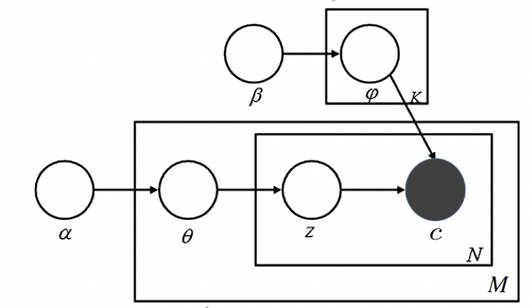
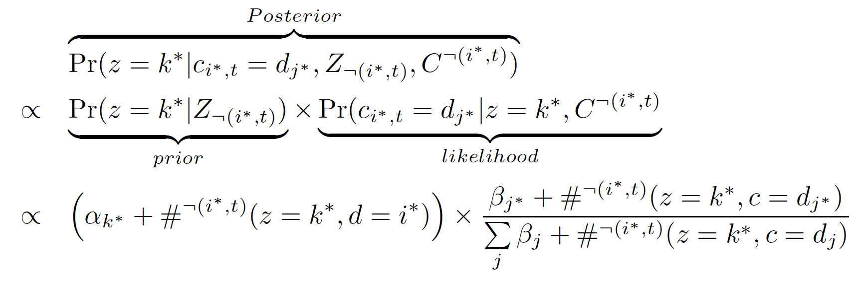
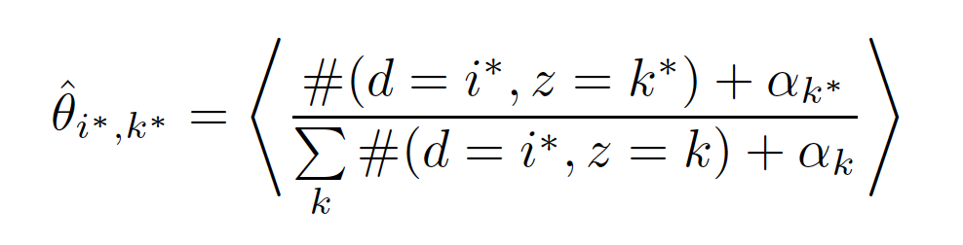
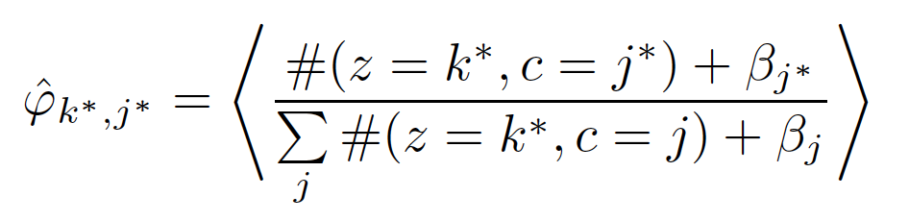
Citation-LDA
Multinomial over Cited Papers Given a Topic
 | LDA | Citation-LDA
Topic | Distribution over Words | Distribution over Cited Papers
Document | Bag of Words | Bag of Cited Papers
Gibbs Sampling of z:
Multinomial over Latent Topics Given a Citing Paper
Posterior Expectation:
Notes:
The generative model is no different from the LDA model.
However, each topic is a distribution over cited papers
and each document is represented as a bag of cited papers.

Slide 12
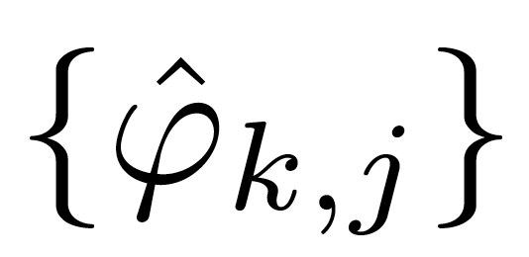
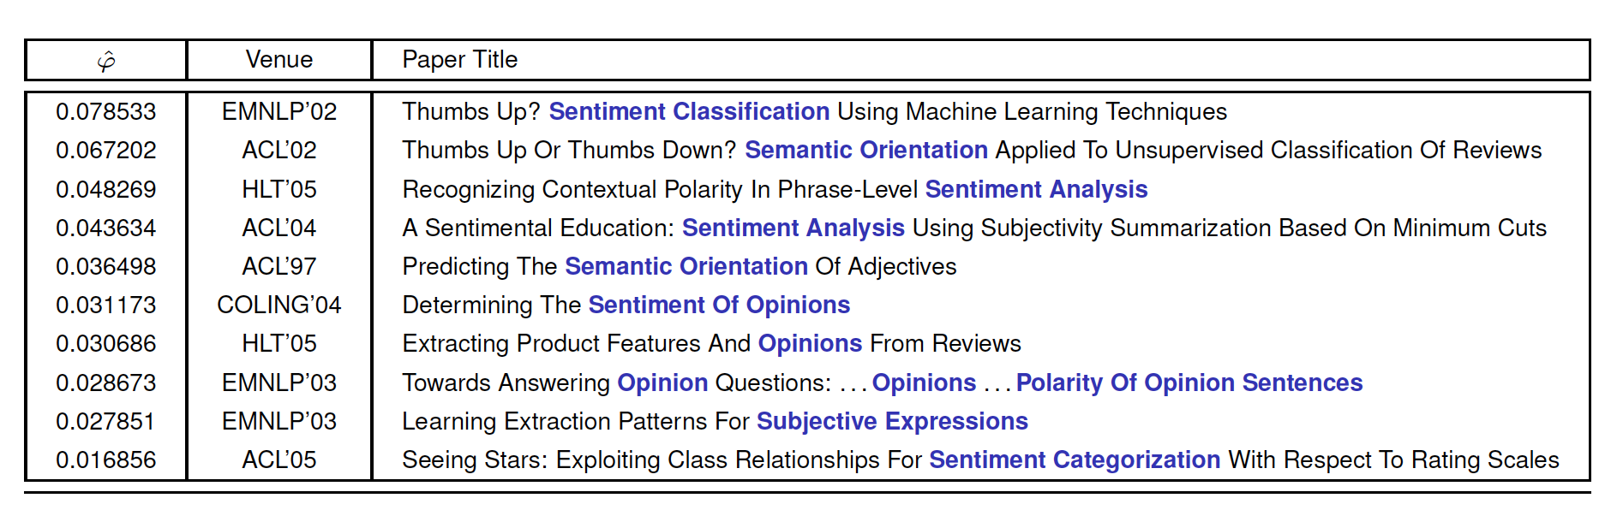
Discovery of Research Topics
1. Topic Milestone Papers
Rank papers by , probability of citing paper j in topic k
ACL Anthology Network (AAN), Topic 89 of 100 Topics
Notes:
It means 7 percent of sentiment analysis papers cite Pang Bo's paper

Slide 13
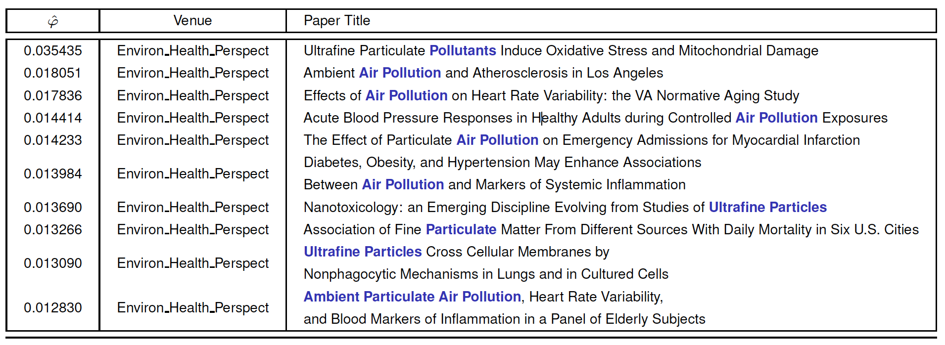
Discovery of Research Topics
1. Topic Milestone Papers
Rank papers by , probability of citing paper j in topic k
PubMed, Topic 175 of 500 Topics
Notes:
Air pollution

Slide 14
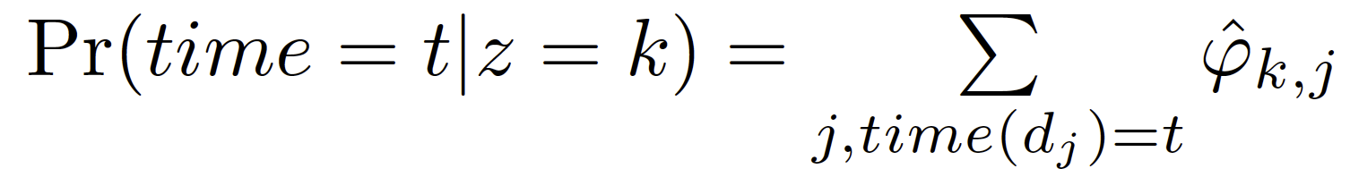
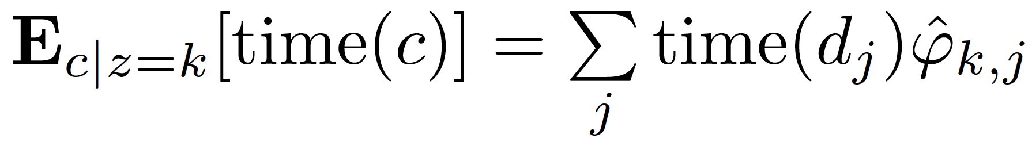
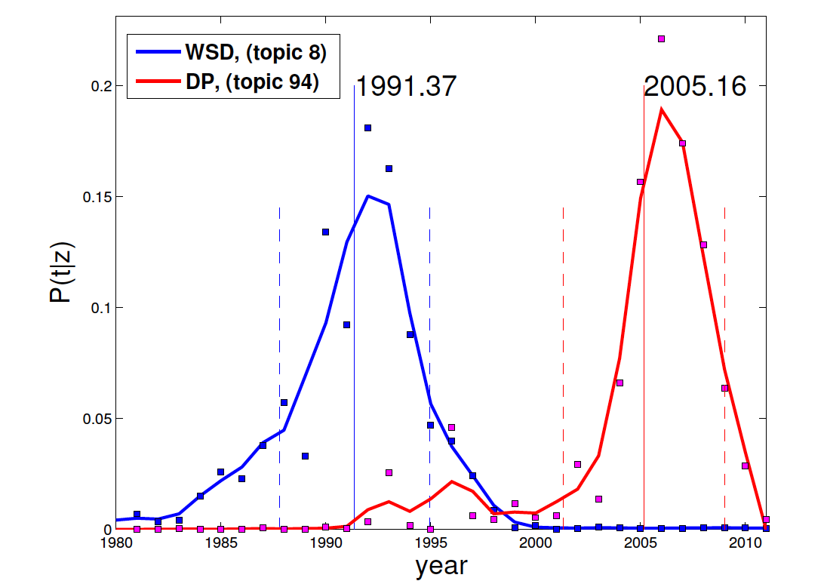
Discovery of Research Topics
2. Topic Temporal Strength
Temporal distribution
Topic expectation time
Word Sense Disambiguation (WSD) 8th topic in AAN
Dependency Parsing (DP) 94th topic in AAN
Notes:
The expectation time can be regarded as the peaked time when the topic was most researched

Slide 15
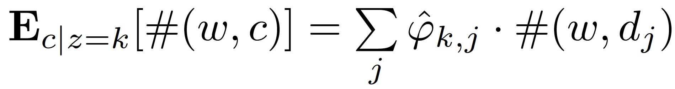
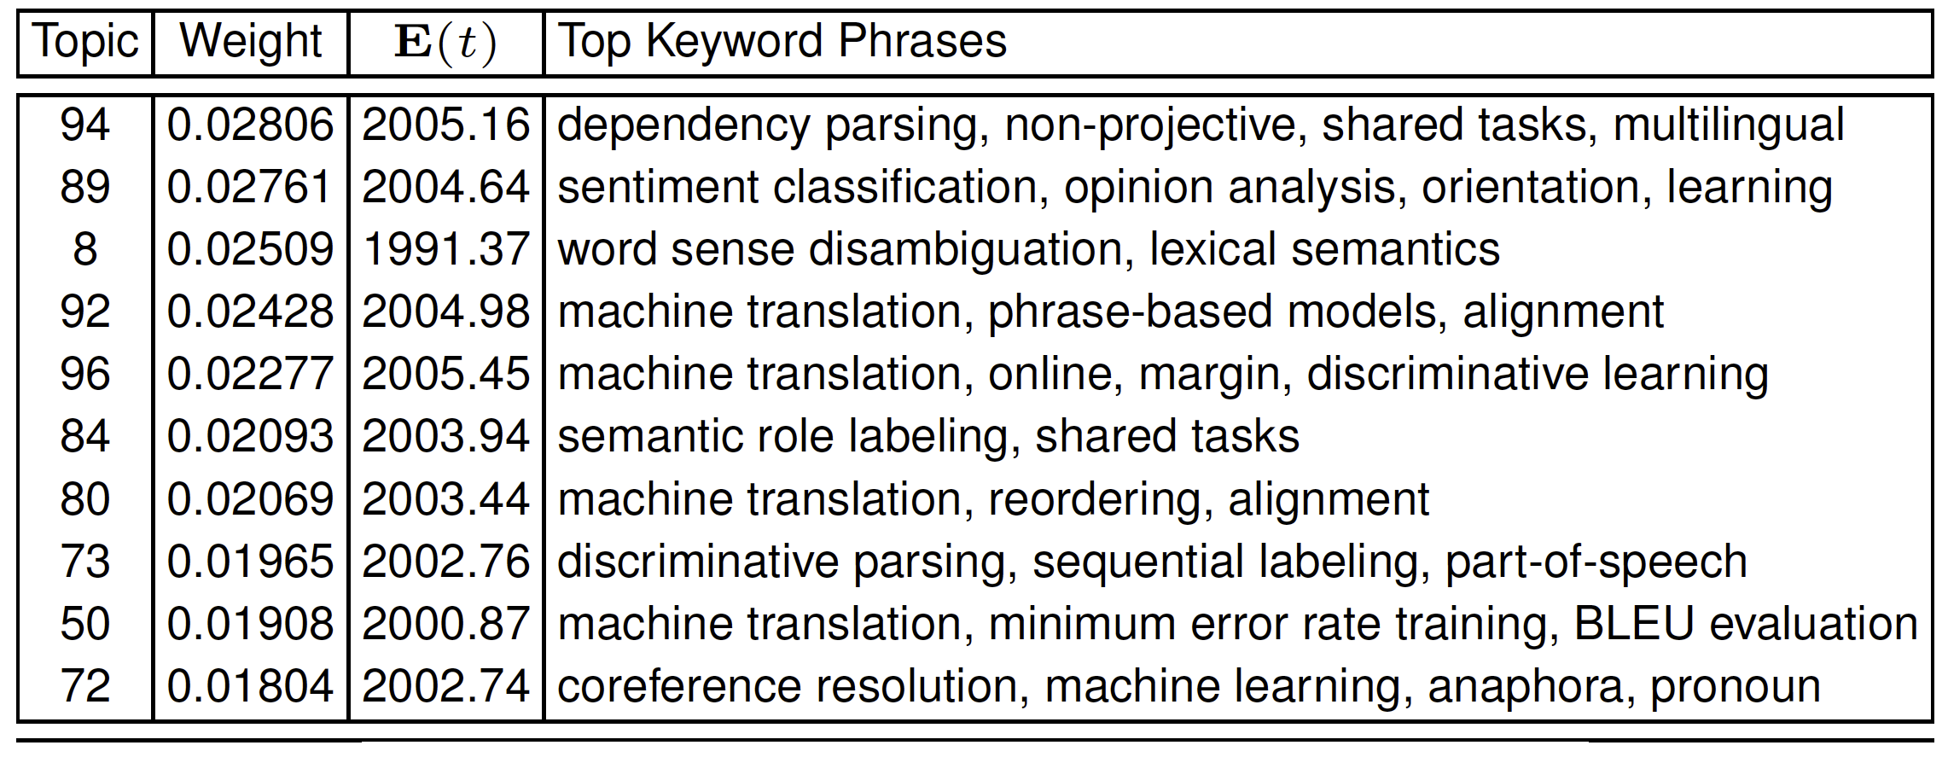
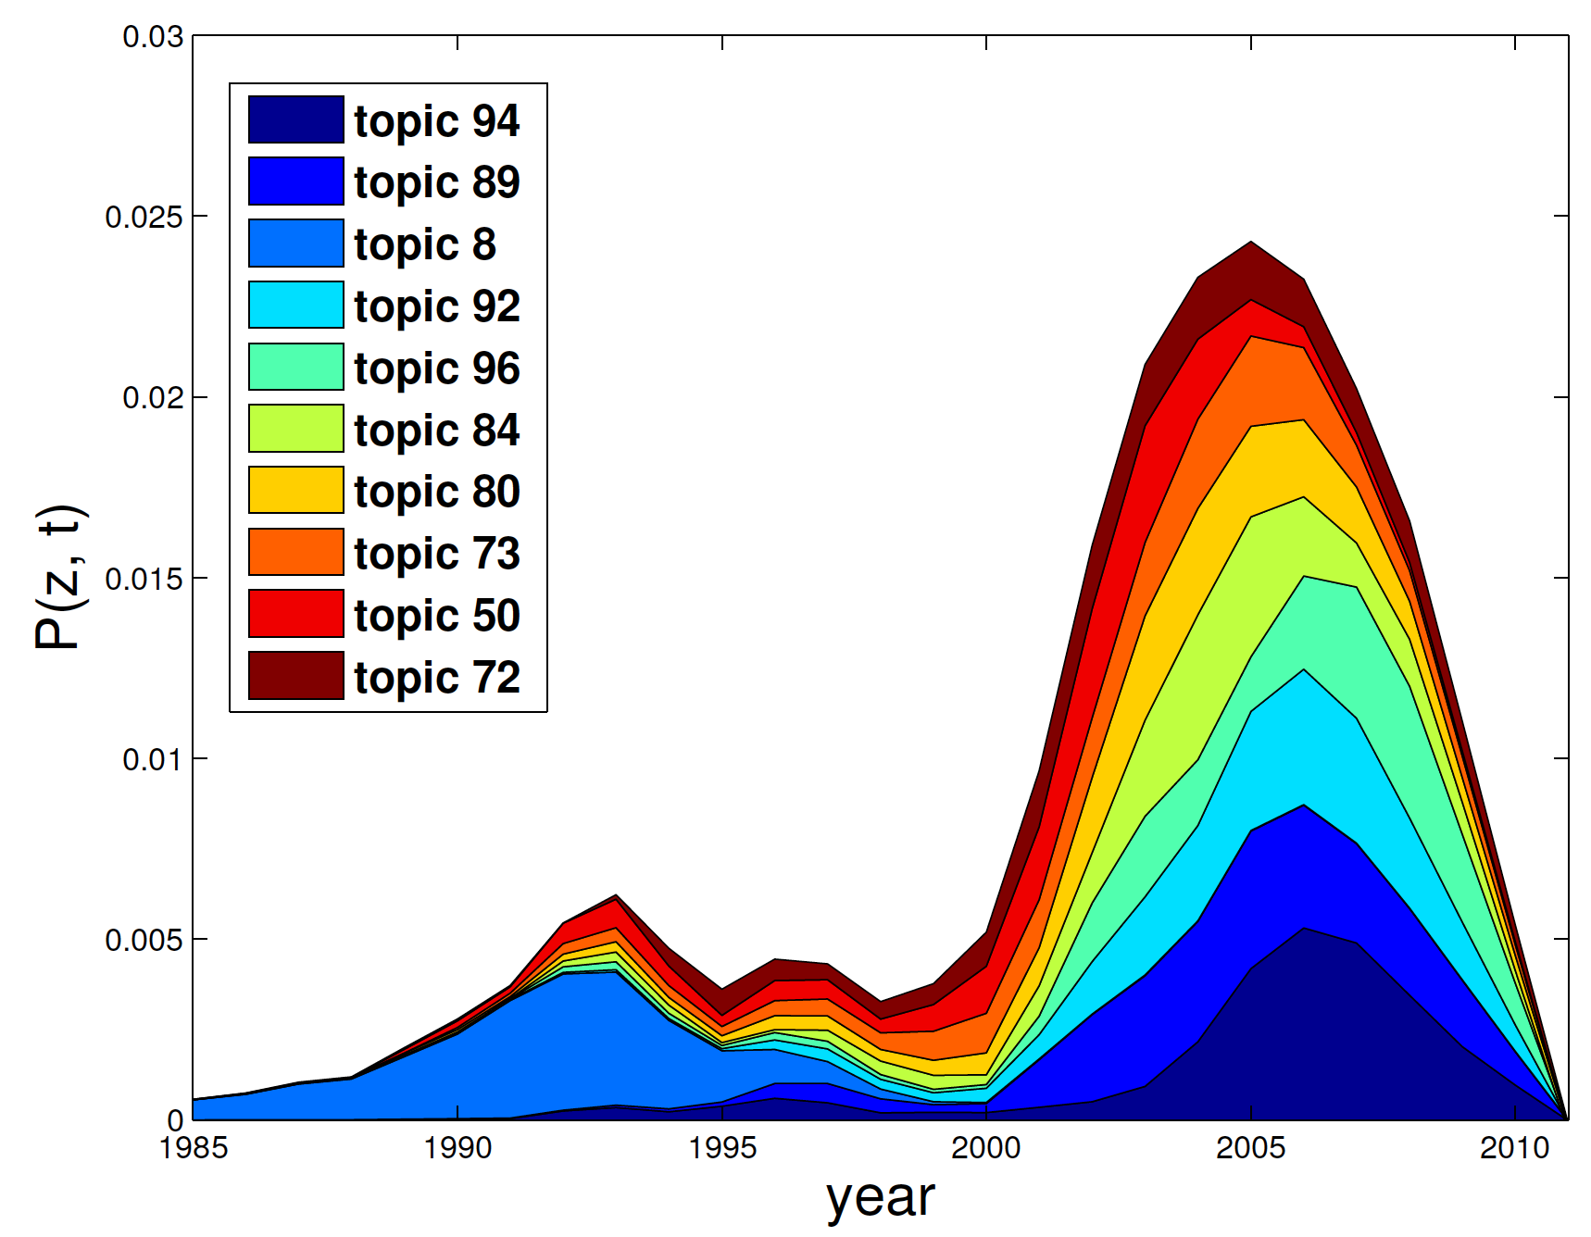
Discovery of Research Topics
3. Topic Keywords
Extract words of title (or abstract)
Top 10 Topics in AAN
Notes:
Those are 10 most dominant topics in AAN, such as dependency parsing, sentiment analysis, WSD. Especially, we find
Machine translation a big research theme composed of multiple research topics such as

Slide 16
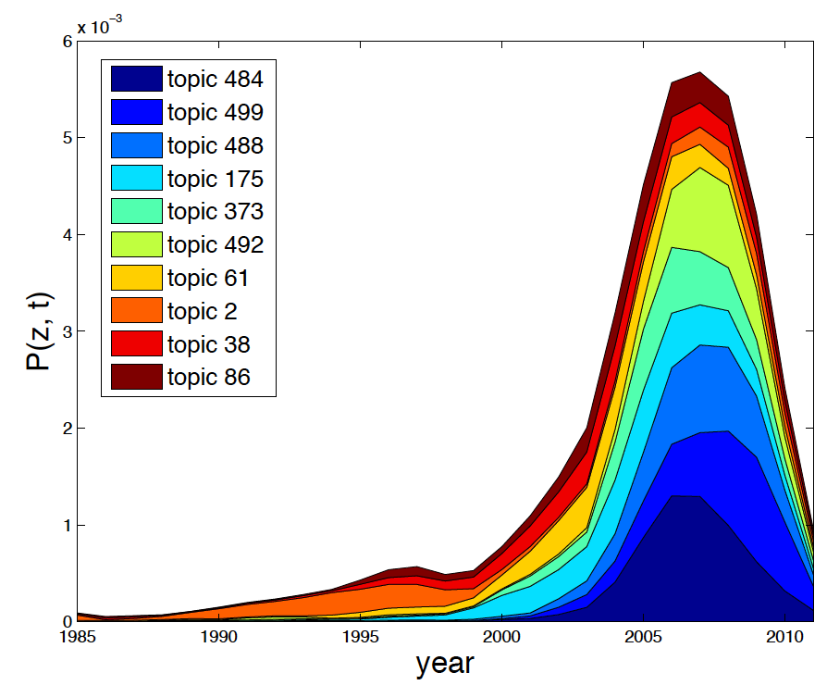
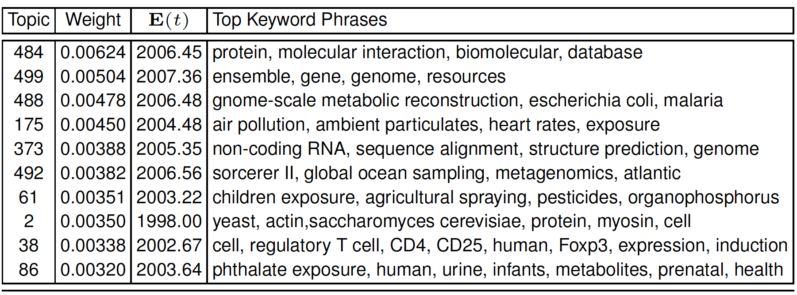
Discovery of Research Topics
3. Topic Keywords
Extract words of title (or abstract)
Top 10 Topics in PubMed

Slide 17
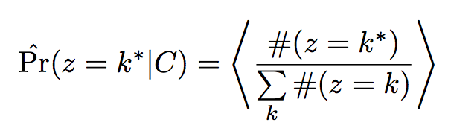
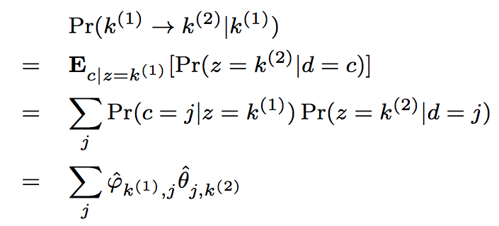
Discovering the Theme Evolution
4. Topic Importance
Rank topic by
5. Topic Dependency
Topic k⁽¹⁾ citing Topic k⁽²⁾
6. Evolution Patterns
Plot the graph
of dependencies
between topics
Chance of paper j citing topic k⁽²⁾
Importance of paper j in topic k⁽¹⁾
Notes:
Topic importance is computed as the empirical distribution of
Samples from a topic
Dependency is mathematically represented as the probability of
Given a topic, what’s the probability of citing another topic.
And to compute, we just need to marginalize through all the possible papers
It also can be leveraged to compute the evolution patterns where each edge
Is computed as the denpendency

Slide 18
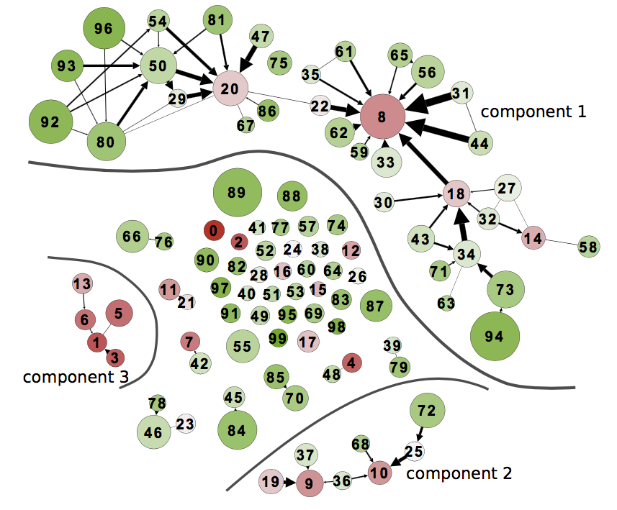
Discovering the Theme Evolution
Word Sense Disambiguation, 91’
Statistical Machine Translation
Prepositional Phrase Attachment, 94’
Statistical Parsing, 99’
Grammars
(faded in 90s)
Discriminative Parsing, 03’
Dependency Parsing, 05’
Discourse/Dialogue
Summarization
AAN
Notes:
Thickness of edge represents the dependency from one topic to another topic.
We only plot a edge if the dependency is significant. And it can be used to show
Research theme evolution

Slide 19
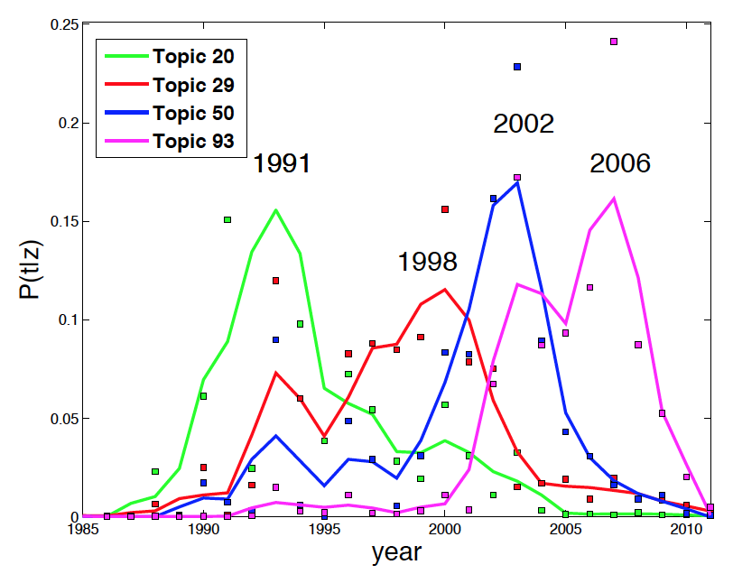
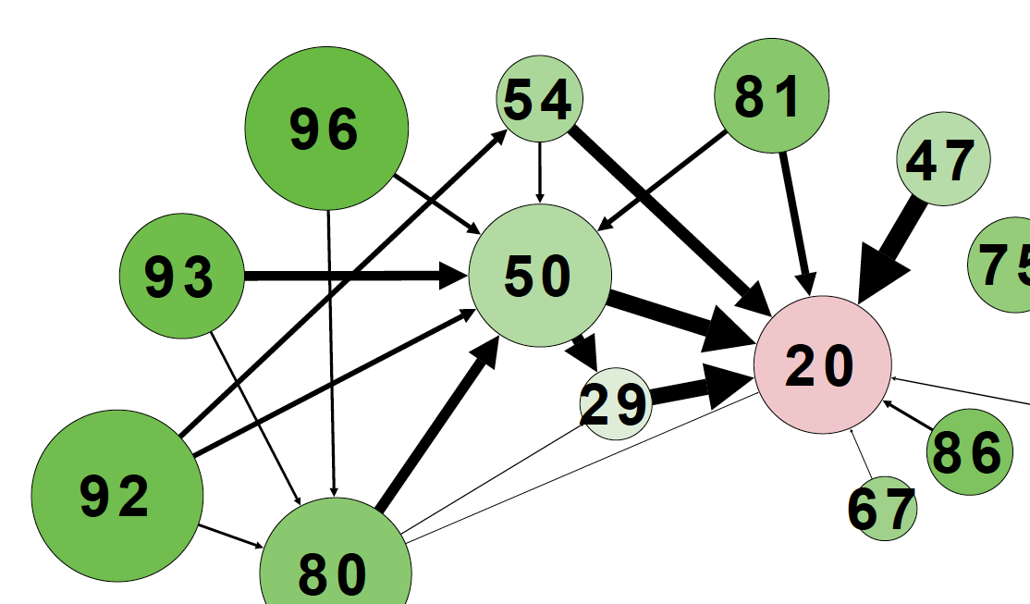
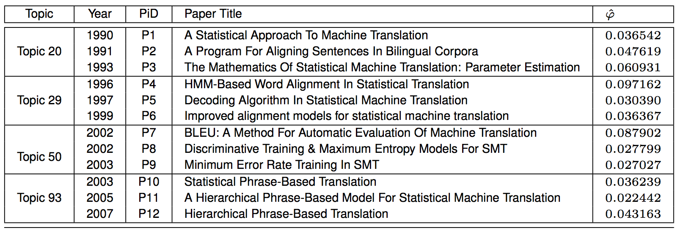
Discovering the Theme Evolution
Statistical Machine Translation

Slide 20
Citation-LDA: Summary
Modeling Citations as a Mixture of Latent Topics
Discovering Research Topics:
milestone papers, temporal strength, Keywords
Discovery the Theme Evolution:
topic importance and dependency, theme evolution patterns
Citation-LDA: a General Modelling Method for Network Data

Slide 21
Citation LDA: Understanding Evolution of Research Themes
Dual Clustering Maximum Entropy
PLANS: Phrasal Latent Allocation with Negative Sampling
Thurstonian Pairwise Preference

Slide 22


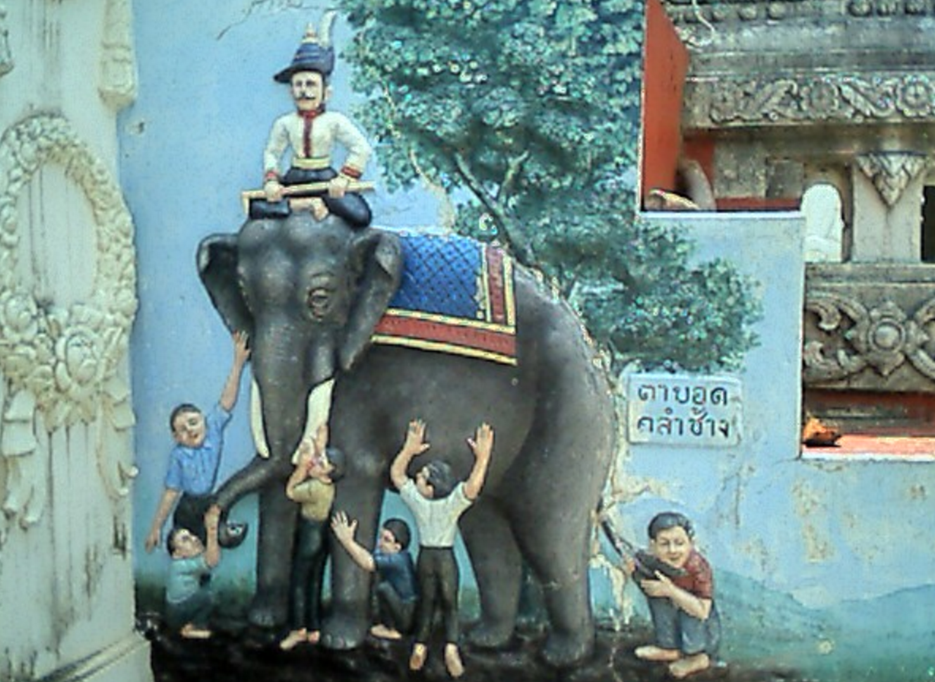



Blind Men and The Elephant: From Ranking to Pairwise Preferences
a Complicated Problem
a Series of Smaller and Easier Tasks
Ranking
annotated by
Experts
Pairwise Preferences
annotated by
Crowd Workers
Thustonian Pairwise Preference (TPP)
Query Difficulty and domain
Worker expertise and truthfulness
Challenges:
Incompleteness and Inconsistency
Notes:
Suppose we have a complicated problem, it is natural to break down the problem into
a series of smaller and easier tasks.
Just like blind men and the elephant, though the ability of each blind men is limited,
They can each touch a part of the elephant such as tusks or the leg.
However, if there is no an intelligent thinking machine to synthesis the
observations, they would disagree, and argue and there is no conclusion achieved.
The major challenges is to resolve incompleteness and inconsistency.
We investigate this idea in the crowdsourcing setting. Insetad of annotating
Ranked list by experts, we ask crowd workers to label only pairwise preferences.
Our challenges is because of the non-expert nature of the workers, we need to estimate
Query difficulty, domain, worker expertise and truthfulness.

Slide 23
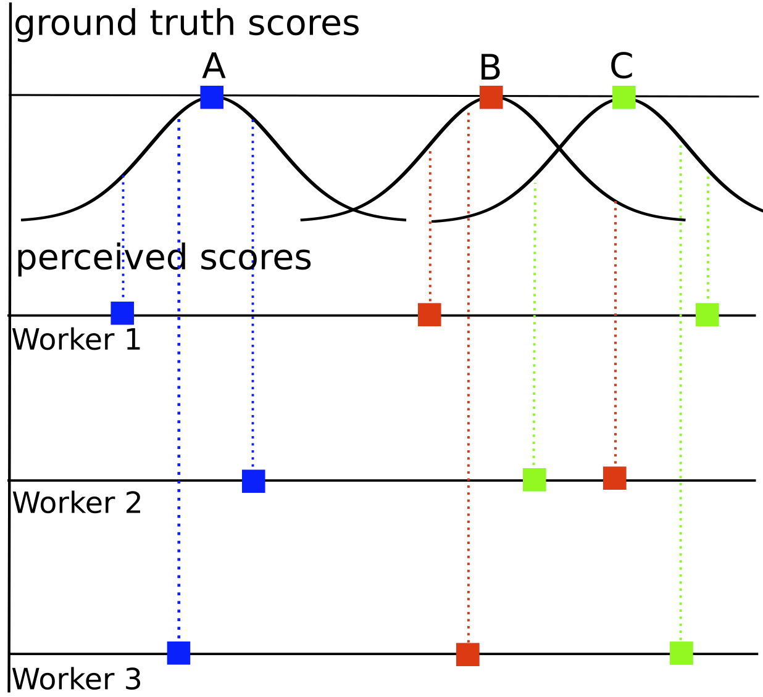
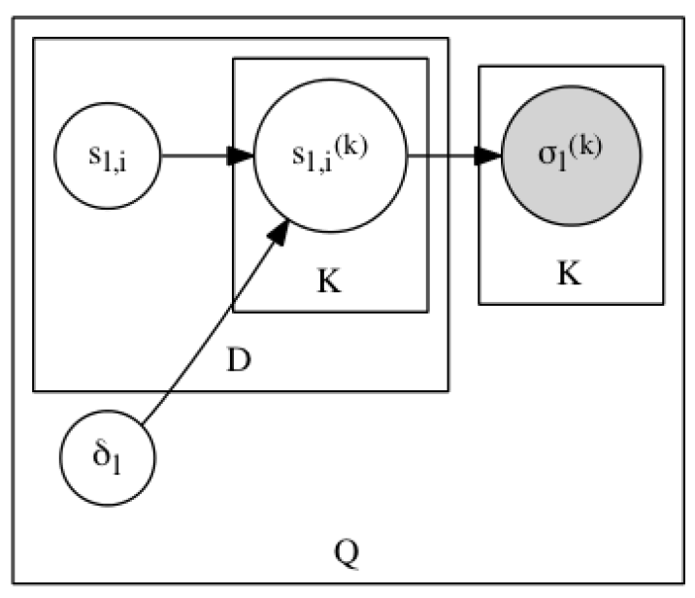
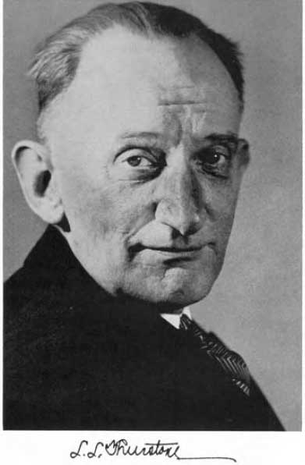



Thurstonian Ranking Model (TRM): PLVM for Ranked Lists
ground truth score (mean)
perceived score
Worker
A > B > C
Doc
Louis Leon Thurstone
1887 - 1955
difficulty (std)
Observation:
ranking
A > C > B
Query
A > B > C
First scalable algorithm
Gibbs sampling
By Ulf Böckenholt (92’-93’), (was) a UIUC Professor
Which one or what is the true ranking?
TRM is a PLVM modelling ranked lists as judgements following normal distributions
Ulf Böckenholt
Notes:
Let us first take a moment to consider a simpler problem where our observation is the ranked
lists annotated by workers, and the goal is to estimate the ground truth ranked lists. Thurstonian
Proposed the TRM.
He assumed that the judgements of the ranked lists is a result of the real-value perceived scores
From each worker and the worker’s perceived score is distributed as normal with means called
Ground truth scores.
The first practical algorithm for optimization was proposed by bockenholt. He was a uiuc professor
When the work was done. Estimation was done using gibbs sampling

Slide 24
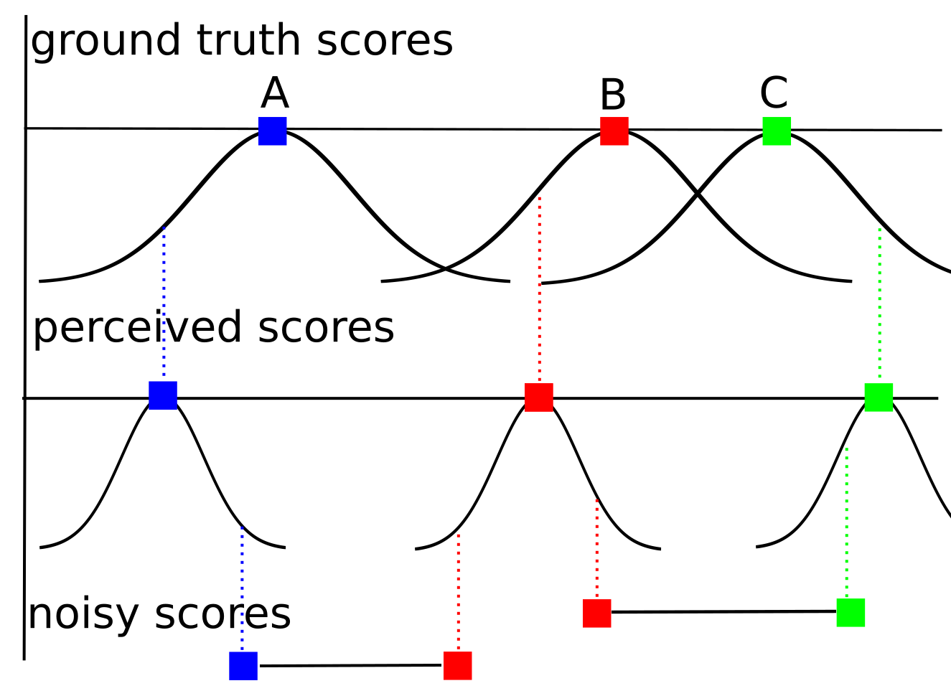
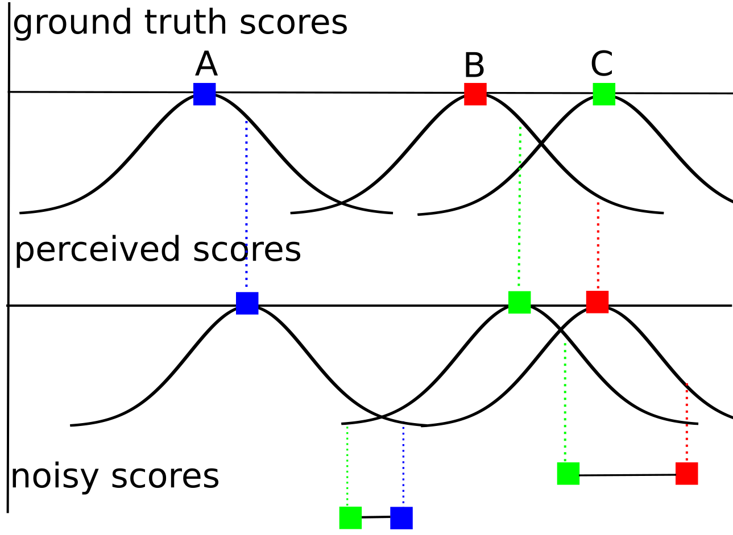
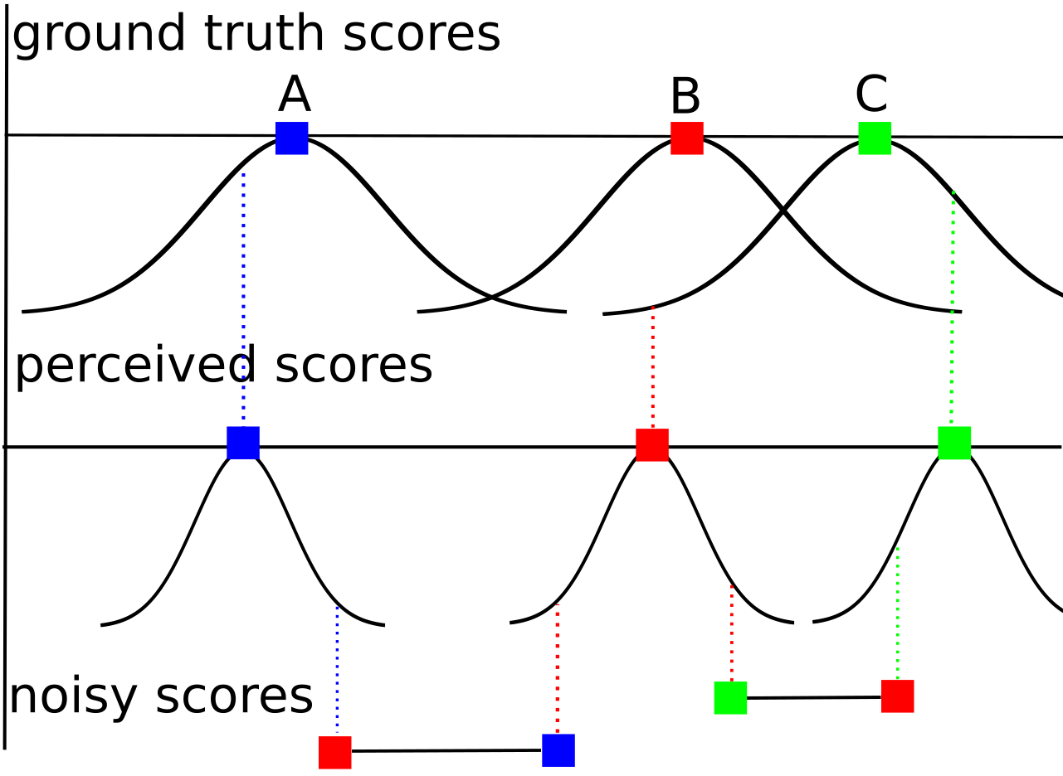

Thurstonian Pairwise Preference (TPP): PLVM for Pairwise judgements
Modelling Pairwise Preferences:
No Error
Error due to Low Expertise
Error due to “Flipping”
Expert (on the query domain)
Truthful
Limited expertise
Truthful
Expert
Malicious
Error due to Difficult Query
Notes:
After generating the perceived score, in our setting we need to further generate the pairwise preferences.
We assume in addition to TRM, there is another step of generation, which draws noisy score from normal
distributions with mean being the perceived scores. The variance of this normal distribution is determined by
The domain expertise of the workers as well as their truthfulness.
Here are some examples.

Slide 25
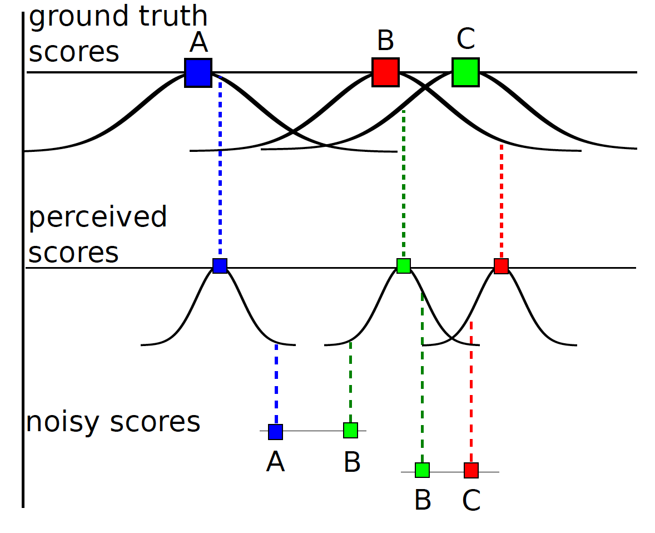
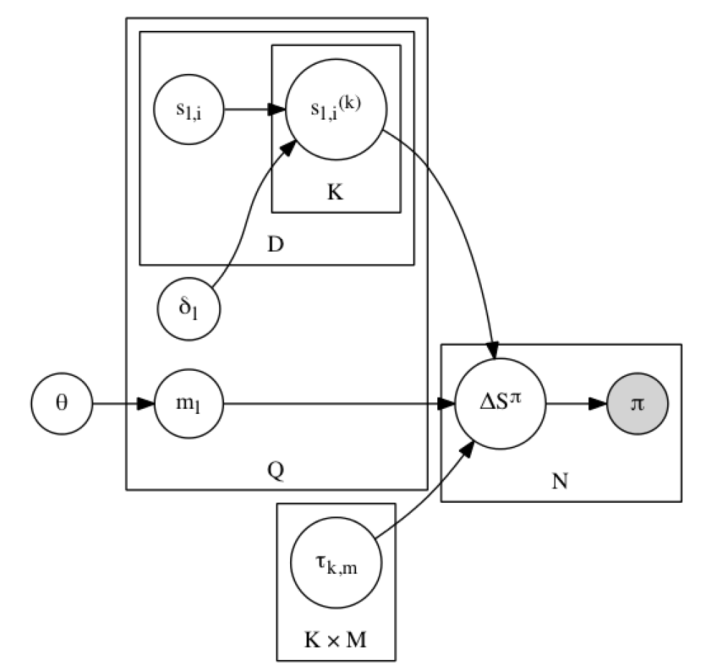
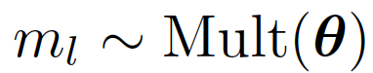
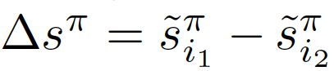
Thurstonian Pairwise Preference
ground truth score (mean)
perceived score
(mean)
Worker
Doc
noisy score difference
query domain
mixture prior
difficulty (std)
TRM
domain
Judgement
query domain:
Query
expertise and
truthfulness (std)
Observation:
pairwise preference
noisy score:
Worker ☓ Domain
difference:

Slide 26

Thurstonian Pairwise Preference
noisy score:
difference:
spammer
$$τ$$
malicious
0
expert

Slide 27
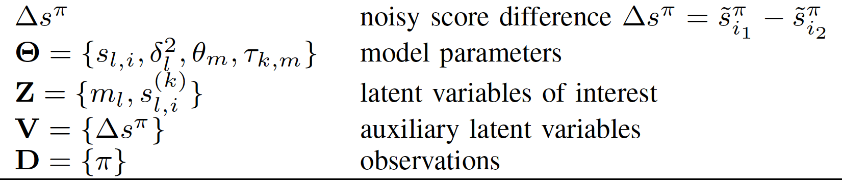
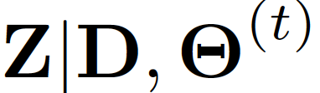
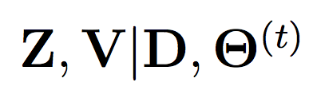
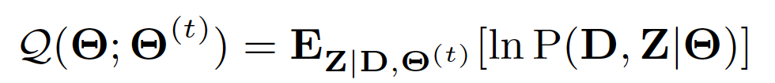
Thurstonian Pairwise Preference
EM algorithm:
intractable posterior
E-step
sampling-friendly posterior
M-step

Slide 28
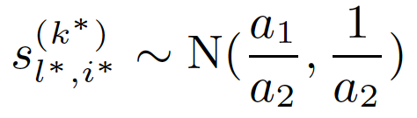
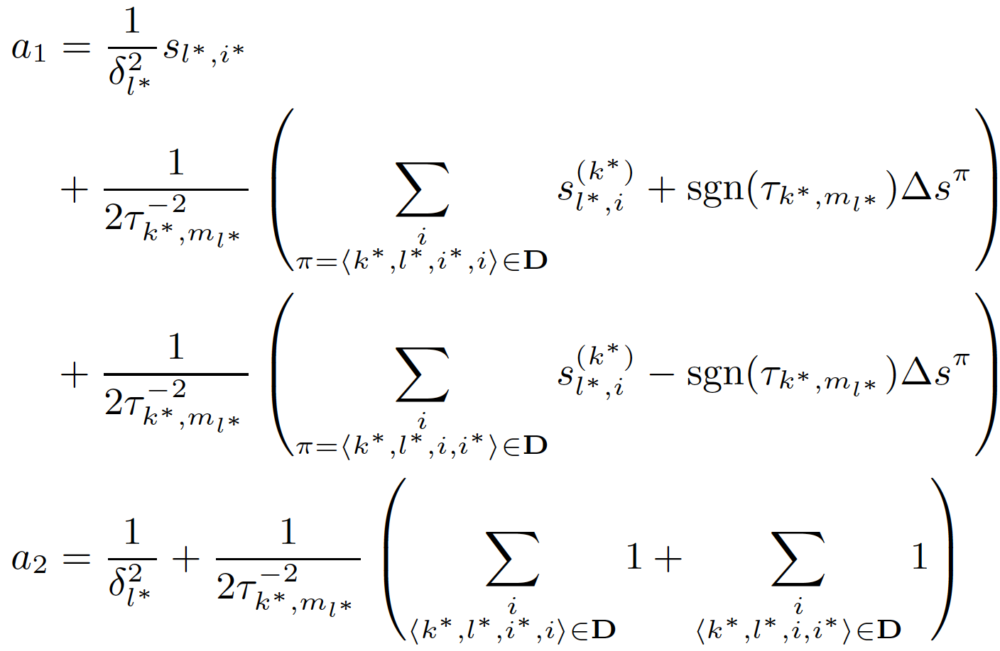
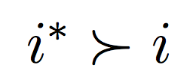
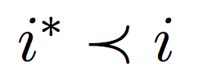
TPP: Learning by Comparison
E-step
Sample perceived score:
winning
Losing
query difficulty
domain expertise

Slide 29
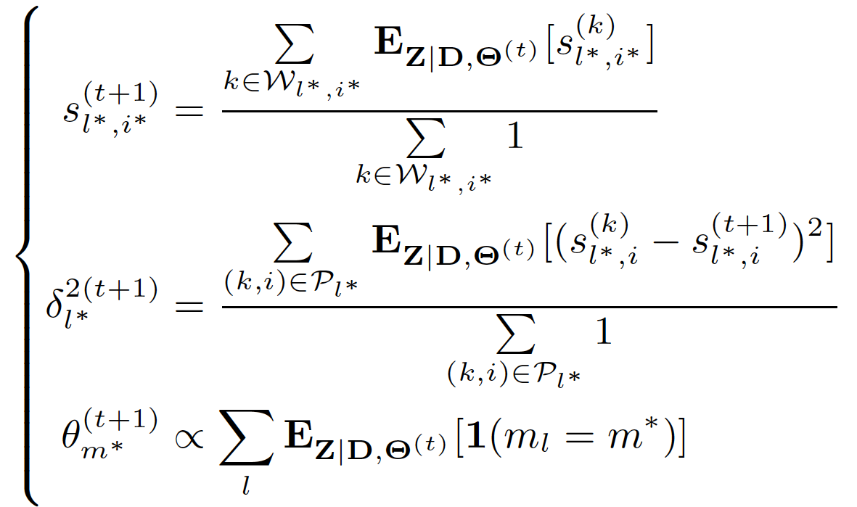
TPP: Majority Voting
M-step
empirical mean
of samples
empirical variance
of samples
empirical multinomial
of samples

Slide 30
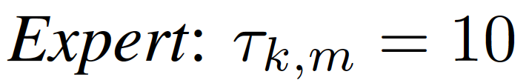





TPP: Simulated Study
0.2
0.6
0.1
0.1
Demo 1
0.2
0.4
0.3
0.1
Demo 2
0.2
0.4
0.1
0.3
Demo 3
5 docs
30 docs
full model
same worker expertise
(Chen et al., 2013)
only 1 domain
same query difficulty

Slide 31


TPP: Domain Prediction and Efficiency

Slide 32

TPP: Malicious Worker Detection
100/200 annotators
10 malicious workers in 100 group
20 malicious workers in 200 group
Sparsity ratio
0.01 (4.35 out of 435 pairs)
0.02 (8.7 out of 435 pairs)

Slide 33

TPP: Rank Aggregation
25 retrieval systems
25 workers for TPP
Rank Aggregation Baselines:
TRM
BordaCount
Majority Voting for Ranking

Slide 34
TPP: Summary
Modeling Pairwise Preferences in Crowdsourcing by
extending Thurstonian Ranking Model
explaining errors/uncertainty with a multitude of sources
Knowledge Discovering of
query difficulty, query domain
worker domain expertise, worker truthfulness
Efficient Optimization with
EM algorithm: E-step by sampling

Slide 35
Citation LDA: Understanding Evolution of Research Themes
Dual Clustering Maximum Entropy
PLANS: Phrasal Latent Allocation with Negative Sampling
Thurstonian Pairwise Preference

Slide 36


Maximum Entropy: A Versatile Tool
Maximum Entropy (ME) Framework:
Classification: with known feature vector
hypothesis for
positive class
t-th feature
vector
x_{t}
hypothesis for
negative class
w₁
w₂
f_{t}(neg)
f_{t}(pos)

Slide 37


Maximum Entropy: A Versatile Tool
Maximum Entropy (ME) Framework:
Embedding: with unknown feature vector (representation)
recursive ?? network
?? = neural vs ?? = social
f_{t}(neural)
Continuous Bag-of-Words (CBOW)
(Milokov et al. 2013)
v_{neural}
h_{network}
h_{recursive}
v_{social}
f_{t}(social)

Slide 38

Maximum Entropy: Difficulty in Scaling
Classes: >10☓E4 MeSH (Medical Subject Heading) tags
Vocabulary: >1M words
How Does Gradient Descent (GD) of ME works?
w₁
x_{t}
w₂
f_{t}(1)
w₃
3-class classification

Slide 39
Maximum Entropy: Difficulty in Scaling
Classes: >10☓E4 MeSH (Medical Subject Heading) tags
Vocabulary: >1M words
How Does Gradient Descent (GD) of ME works?
w₁
x_{t}
w₂
f_{t}(2)
w₃
3-class classification

Slide 40
Maximum Entropy: Difficulty in Scaling
Classes: >10☓E4 MeSH (Medical Subject Heading) tags
Vocabulary: >1M words
How Does Gradient Descent (GD) of ME works?
w₁
x_{t}
w₂
f_{t}(3)
w₃
3-class classification

Slide 41




Maximum Entropy: Difficulty in Scaling
Classes: >10☓E4 MeSH (Medical Subject Heading) tags
Vocabulary: >1M words
How Does Gradient Descent (GD) of ME works?
w₁
suppose y_{t} = 1, gradient descent updates:
x_{t}
w₂
w₃
3-class classification

Slide 42
Maximum Entropy: Difficulty in Scaling
Classes: >10☓E4 MeSH (Medical Subject Heading) tags
Vocabulary: >1M words
How Does Gradient Descent (GD) of ME works?
w₁
suppose y_{t} = 1, gradient descent updates:
x_{t}
w₂
w₃
3-class classification

Slide 43
Maximum Entropy: Difficulty in Scaling
Classes: >10☓E4 MeSH (Medical Subject Heading) tags
Vocabulary: >1M words
How Does Gradient Descent (GD) of ME works?
w₁
suppose y_{t} = 1, gradient descent updates:
x_{t}
w₂
w₃
3-class classification

Slide 44
Maximum Entropy: Difficulty in Scaling
Classes: >10☓E4 MeSH (Medical Subject Heading) tags
Vocabulary: >1M words
How Does Gradient Descent (GD) of ME works?
w₁
GD Complexity:
O(DN)
D – feature dimensionality
N – number of classes
suppose y_{t} = 1, gradient descent updates:
x_{t}
w₂
3-class classification
w₃

Slide 45


Dual-Clustering Maximum Entropy (DCME)
w₁
w₁
x_{t}
w₁
x_{t}
w₂
w₂
w₂
GD Complexity:
O(DN)
D – feature dimensionality
N – number of classes
x_{t}
w₃
w₃
w₃
t = 1, y_{t} =1
t = 2, y_{t} =2
t = 3, y_{t} = 3
Insight:
If distributions P_{t} are same,
computation in online/offline is efficient
x₁
x₂
w₁
w₂
x₃
w₃

Slide 46
Dual-Clustering Maximum Entropy (DCME)
w₁
w₁
x_{t}
w₁
x_{t}
w₂
w₂
w₂
GD Complexity:
O(DN)
D – feature dimensionality
N – number of classes
x_{t}
w₃
w₃
w₃
t = 1, y_{t} =1
t = 2, y_{t} =2
t = 3, y_{t} = 3
Insight:
If distributions P_{t} are same,
computation in online/offline is efficient
x₁
w₁
x₂
w₂
w₃
x₃

Slide 47
Dual-Clustering Maximum Entropy (DCME)
w₁
w₁
x_{t}
w₁
x_{t}
w₂
w₂
w₂
GD Complexity:
O(DN)
D – feature dimensionality
N – number of classes
x_{t}
w₃
w₃
w₃
t = 1, y_{t} =1
t = 2, y_{t} =2
t = 3, y_{t} = 3
x₃
Insight:
If distributions P_{t} are same,
computation in online/offline is efficient
x₂
x₁

Slide 48




Dual-Clustering Maximum Entropy (DCME)
w₁
w₁
x_{t}
w₁
x_{t}
w₂
w₂
w₂
GD Complexity:
O(DN)
D – feature dimensionality
N – number of classes
x_{t}
w₃
w₃
w₃
t = 1, y_{t} =1
t = 2, y_{t} =2
t = 3, y_{t} = 3
x₃
Insight:
If distributions P_{t} are same,
computation in online/offline is efficient
x₂
x₁ + x₂ + x₃
x₁
w₁
w₂
w₃

Slide 49


Dual-Clustering Maximum Entropy (DCME)
w₁
w₁
x_{t}
w₁
x_{t}
w₂
w₂
w₂
x_{t}
Which distribution P is optimal?
w₃
w₃
w₃
t = 1, y_{t} =1
t = 2, y_{t} =2
t = 3, y_{t} = 3
Goal:
A Time Complexity
Independent of N
Solution: Approximating/Clustering Dual Distributions {P_{t}}
DCME Complexity:
O(DK)
D – feature dimensionality
K – number of clusters
if mini-batch size = O(N)
Distributions on Simplex

Slide 50



DCME: Primal-Dual ME
Conjugate between Log Partition and Negative Entropy:

Slide 51



DCME: Primal-Dual ME
Conjugate between Log Partition and Negative Entropy:
Maximum Entropy
Primal-Dual ME

Slide 52



DCME: Primal-Dual ME
Primal-Dual ME
Dual-Clustering ME

Slide 53


DCME: Dual-Clustering
Using Conjugate
Again!
Updating cluster assignments (Online):
Updating cluster centers (Offline)

Slide 54

DCME: Dual-Clustering
Dual-Clustering:
K-means with Two Ingredients:
Clustering in the Simplex Space
Instead of Euclidean space
Measuring “Distance” in KL Divergence
Instead of L₂ distance

Slide 55


DCME: Dual Form as Feature Pursuit
DCME:
ME:

Slide 56

DCME: Experiment on Classification and Embedding
Baselines:
Gradient Descent
Noise-Contrastive Estimation
Negative Sampling
(Mikolov et al. 2013 )

Slide 57
DCME: Summary
Modeling Dual Distributions in Maximum Entropy:
K-means latent clustering
Approximating each distribution by the corresponding cluster center
Scalable Optimization:
A hybrid online-offline algorithm
Complexity depends only on #cluster, but not #class
Effective model update: no sampling involved

Slide 58
Citation LDA: Understanding Evolution of Research Themes
Dual Clustering Maximum Entropy
PLANS: Phrasal Latent Allocation with Negative Sampling
Thurstonian Pairwise Preference

Slide 59

Embedding: Beyond Word Representation
Word Embedding: A Skipgram Scheme
W_{t-2}
W_{t-1}
W_{t}
W_{t+1}
W_{t+2}
Maximize: log P(w_{t-2}|w_{t})

Slide 60

Embedding: Beyond Word Representation
Word Embedding: A Skipgram Scheme
W_{t-2}
W_{t-1}
W_{t}
W_{t+1}
W_{t+2}
Maximize: log P(w_{t-2}|w_{t}) + log P(w_{t-1}|w_{t})

Slide 61

Embedding: Beyond Word Representation
Word Embedding: A Skipgram Scheme
W_{t-2}
W_{t-1}
W_{t}
W_{t+1}
W_{t+2}
Maximize: log P(w_{t-2}|w_{t}) + log P(w_{t-1}|w_{t}) + log P(w_{t+1}|w_{t})

Slide 62

Embedding: Beyond Word Representation
Word Embedding: A Skipgram Scheme
W_{t-2}
W_{t-1}
W_{t}
W_{t+1}
W_{t+2}
Maximize: log P(w_{t-2}|w_{t}) + log P(w_{t-1}|w_{t}) + log P(w_{t+1}|w_{t}) + log P(w_{t+2}|w_{t})
Limitations of Bag-of-Words Assumption:
Words are contextually unaware
bank
“I made a deposit in the bank.”
“We walked on the river bank.”

Slide 63
Embedding: Beyond Word Representation
Word Embedding: A Skipgram Scheme
W_{t-2}
W_{t-1}
W_{t}
W_{t+1}
W_{t+2}
Maximize: log P(w_{t-2}|w_{t}) + log P(w_{t-1}|w_{t}) + log P(w_{t+1}|w_{t}) + log P(w_{t+2}|w_{t})
Limitations of Bag-of-Words Assumption:
Words are contextually unaware
Sentence is simple average of words
presidential residence
the White House
a house in white
Machine
Human

Slide 64
PLANS: Phrasal Latent Allocation with Negative Sampling
Jointly Learning of:
Phrasal Allocation
computer
scientists
working
in
artificial
intelligence
and
machine
learning
artificial

Slide 65
PLANS: Phrasal Latent Allocation with Negative Sampling
Jointly Learning of:
Phrasal Allocation
computer
scientists
working
in
artificial
intelligence
and
machine
learning
in artificial

Slide 66
PLANS: Phrasal Latent Allocation with Negative Sampling
Jointly Learning of:
Phrasal Allocation
computer
scientists
working
in
artificial
intelligence
and
machine
learning
working in artificial

Slide 67
PLANS: Phrasal Latent Allocation with Negative Sampling
Jointly Learning of:
Phrasal Allocation
computer
scientists
working
in
artificial
intelligence
and
machine
learning
in artificial intelligence

Slide 68
PLANS: Phrasal Latent Allocation with Negative Sampling
Jointly Learning of:
Phrasal Allocation
computer
scientists
working
in
artificial
intelligence
and
machine
learning
artificial intelligence and

Slide 69
PLANS: Phrasal Latent Allocation with Negative Sampling
Jointly Learning of:
Phrasal Allocation
computer
scientists
working
in
artificial
intelligence
and
machine
learning
artificial intelligence

Slide 70




PLANS: Phrasal Latent Allocation with Negative Sampling
Jointly Learning of:
Phrasal Allocation
Embedding Estimation
computer
scientists
working
in
artificial
intelligence
and
machine
learning
artificial intelligence
artificial intelligence
algorithm
machine learning
artificial food additives
Embedding space

Slide 71


PLANS: Ingredient 1 Transient Chinese Restaurant Process
Chinese Restaurant Process
…

Slide 72

PLANS: Ingredient 1 Transient Chinese Restaurant Process
Chinese Restaurant Process
…
1
$$α$$

Slide 73
PLANS: Ingredient 1 Transient Chinese Restaurant Process
Chinese Restaurant Process
…
1
$$α$$

Slide 74
PLANS: Ingredient 1 Transient Chinese Restaurant Process
Chinese Restaurant Process
…
2
$$α$$

Slide 75
PLANS: Ingredient 1 Transient Chinese Restaurant Process
Chinese Restaurant Process
…
2
$$α$$

Slide 76
PLANS: Ingredient 1 Transient Chinese Restaurant Process
Chinese Restaurant Process
…
2
1
$$α$$

Slide 77
PLANS: Ingredient 1 Transient Chinese Restaurant Process
Chinese Restaurant Process
…
2
1
$$α$$

Slide 78
PLANS: Ingredient 1 Transient Chinese Restaurant Process
Chinese Restaurant Process
…
2
1
1
$$α$$

Slide 79
PLANS: Ingredient 1 Transient Chinese Restaurant Process
Chinese Restaurant Process
…
2
1
1
$$α$$

Slide 80
PLANS: Ingredient 1 Transient Chinese Restaurant Process
Chinese Restaurant Process
…
3
1
1
$$α$$

Slide 81
PLANS: Ingredient 1 Transient Chinese Restaurant Process
Transient Chinese Restaurant Process
Seating choice is limited to possible phrases only
…
intelligence 1/3
artificial intelligence 1/3
intelligence algorithms 1/3
artificial intelligence algorithms

Slide 82
PLANS: Ingredient 1 Transient Chinese Restaurant Process
Transient Chinese Restaurant Process
Seating choice is limited to possible phrases only
…
intelligence
intelligence 1/3
artificial intelligence 1/3
intelligence algorithms 1/3
artificial intelligence algorithms

Slide 83

PLANS: Ingredient 1 Transient Chinese Restaurant Process
Transient Chinese Restaurant Process
Seating choice is limited to possible phrases only
…
intelligence
1
$$α$$
intelligence 1
machine intelligence $α$/2
intelligence algorithms $α$/2
machine intelligence algorithms

Slide 84
PLANS: Ingredient 1 Transient Chinese Restaurant Process
Transient Chinese Restaurant Process
Seating choice is limited to possible phrases only
…
intelligence
2
$$α$$
intelligence 1
machine intelligence $α$/2
intelligence algorithms $α$/2
machine intelligence algorithms

Slide 85

PLANS: Ingredient 1 Transient Chinese Restaurant Process
Transient Chinese Restaurant Process
Seating choice is limited to possible phrases only
…
intelligence
2
$$α$$
intelligence 2
artificial intelligence $α$/2
intelligence technique $α$/2
artificial intelligence technique

Slide 86
PLANS: Ingredient 1 Transient Chinese Restaurant Process
Transient Chinese Restaurant Process
Seating choice is limited to possible phrases only
…
intelligence
AI
2
1
$$α$$
intelligence 2
artificial intelligence $α$/2
intelligence technique $α$/2
artificial intelligence technique

Slide 87

PLANS: Ingredient 1 Transient Chinese Restaurant Process
Transient Chinese Restaurant Process
Seating choice is limited to possible phrases only
…
intelligence
AI
2
1
$$α$$
artifical $α\text{/2}$
artificial intelligence 1
in artificial $α$/2
in artifical intelligence

Slide 88
PLANS: Ingredient 1 Transient Chinese Restaurant Process
Transient Chinese Restaurant Process
Seating choice is limited to possible phrases only
…
intelligence
AI
2
2
$$α$$
artifical $α\text{/2}$
artificial intelligence 1
in artificial $α$/2
in artifical intelligence

Slide 89

PLANS: Ingredient 1 Transient Chinese Restaurant Process
Transient Chinese Restaurant Process
Seating choice is limited to possible phrases only
…
intelligence
AI
2
2
$$α$$
theory $α\text{/}$3
learning theory $α\text{/}$3
theory paper $α$/3
learning theory paper

Slide 90
PLANS: Ingredient 1 Transient Chinese Restaurant Process
Transient Chinese Restaurant Process
Seating choice is limited to possible phrases only
…
intelligence
AI
learning theory
2
2
1
$$α$$
theory $α\text{/}$3
learning theory $α\text{/}$3
theory paper $α$/3
learning theory paper

Slide 91

PLANS: Ingredient 1 Transient Chinese Restaurant Process
Transient Chinese Restaurant Process
Seating choice is limited to possible phrases only
…
After a minibatch processed:
Customers leave with probability $β$
Retain only the Top V tables
intelligence
AI
learning theory
ML
6
4
2
4
$$α$$

Slide 92


PLANS: Ingredient 1 Transient Chinese Restaurant Process
Transient Chinese Restaurant Process
Seating choice is limited to possible phrases only
…
After a minibatch processed:
Customers leave with probability $β$
Retain only the Top V tables
intelligence
AI
learning theory
ML
6
4
2
4
$$α$$
Shrink
(aging)
3
2
1
2
$β$=0.5
Customers Leave

Slide 93
PLANS: Ingredient 1 Transient Chinese Restaurant Process
Transient Chinese Restaurant Process
Seating choice is limited to possible phrases only
…
After a minibatch processed:
Customers leave with probability $β$
Retain only the Top V tables
intelligence
AI
learning theory
ML
6
4
2
4
$$α$$
Shrink
(aging)
3
2
1
2
$β$=0.5
Customers Leave

Slide 94

PLANS: Ingredient 1 Transient Chinese Restaurant Process
Transient Chinese Restaurant Process
Seating choice is limited to possible phrases only
…
After a minibatch processed:
Customers leave with probability $β$
Retain only the Top V tables
intelligence
AI
learning theory
ML
$$α$$
Prune
V=3
Clean Tables

Slide 95
PLANS: Ingredient 1 Transient Chinese Restaurant Process
Transient Chinese Restaurant Process
Seating choice is limited to possible phrases only
…
After a minibatch processed:
Customers leave with probability $β$
Retain only the Top V tables
intelligence
AI
ML
tCRP:
is a nonparametric partial-generative model for phrasal allocation
encourages “richer get richer” (co-occrrence)
maintains a affordable size of phrases
prunes phrases by a measurement that
mimics “frequency” in an online learning setting
has an aging effect
$$α$$

Slide 96

PLANS: Ingredient 2 SkimGram with Negative Sampling
Negative Sampling for SkimGram:
W_{t-3}
W_{t-2}
W_{t-1}
W_{t}
W_{t+1}
W_{t+2}
ME
NS
Negative Samples

Slide 97



PLANS: Ingredient 2 SkimGram with Negative Sampling
Negative Sampling for PLANS:
W_{t-3}
W_{t-2}
W_{t-1}
W_{t}
W_{t+1}
W_{t+2}
Phrasal Allocation
tCRP
Negative Sampling

Slide 98

PLANS: Ingredient 2 SkimGram with Negative Sampling
Negative Sampling for PLANS:
W_{t-3}
W_{t-2}
W_{t-1}
W_{t}
W_{t+1}
W_{t+2}
Phrasal Allocation
tCRP
Negative Sampling

Slide 99

PLANS: Ingredient 2 SkimGram with Negative Sampling
Negative Sampling for PLANS:
W_{t-3}
W_{t-2}
W_{t-1}
W_{t}
W_{t+1}
W_{t+2}
Phrasal Allocation
tCRP
Negative Sampling

Slide 100

PLANS: Ingredient 2 SkimGram with Negative Sampling
Negative Sampling for PLANS:
W_{t-3}
W_{t-2}
W_{t-1}
W_{t}
W_{t+1}
W_{t+2}
Phrasal Allocation
tCRP
Negative Sampling
Posterior Sampling
for E-step in EM

Slide 101


PLANS: Ingredient 3 Simulated Annealing
Simulated Annealing (SA) for PLANS:
Decreases the stochastic behavior of sampling towards the end of training
Stabilizes the phrase set, but continues optimizing the embeddings
Example: “solve the phrasal allocation problem with PLANS ”
Phrasal Allocation without SA
SA with temperature T
T=1
T=0.5
T=0.2
T=0.1

Slide 102
PLANS: Evaluation Plan
Intrinsic Evaluation
Data: Wiki dump
Ground Truth:
Wiki has anchor links, and those with multiple words are generally phrases
Performance measurement:
Precision, Recall, F1, etc.
Extrinsic Evaluation
Task: Apply PLANS as the feature representation method for text classification
Data: Movie review sentiment classification
Baselines:
Bag-of-Words, N-gram, Word Embedding, etc.
Performance measurement:
Accuracy

Slide 103

PLANS: Summary
Modeling Phrasal Allocation and Embedding:
Transient Chinese Restaurant
Nonparametric partial-generative model
Dynamically aging, sorting and pruning the phrases
Efficient Optimization -- EM with posterior sampling:
Negative Sampling
Efficient embedding estimation
Simulated Annealing
Reducing stochastic behavior of sampling

Slide 104
PLVM: Conclusion
PLVM Models knowledge as latent variables
Knowledge discover amounts to Maximum Likelihood Estimation or Bayesian Inference
PLVM is a powerful and flexible tool
PLVM is a generative process to explain the observations as distributions parametrized by the latent variables
Each generative step in PLVM is simple and flexible
PLVM Models data of different types: continuous, discrete, distribution, uncertainty, etc.
PLVM can be leveraged for optimization
Improves efficiency of existing algorithms such as Maximum Entropy
For complicated posterior, trade tractability with accuracy by sampling

Slide 105
Thank You!
Questions?

